Slide 1
Tues. , Jan. 22, 2013 Ethos, Pathos, and Logos
“How can I categorize the persuasive techniques that I’ve learned?”
TODAY:
Notes on Ethos, Pathos, and Logos
Begin creating flipbook
What You Need:
pen/pencil
notebook
your brain!
Do Now: Pizza Persuasion
Don’t forget to section this space off!
DO NOW:
Think of at least three strong reasons that you would come up with to convince your busy, healthy-conscious mom that your family should have pizza for dinner tonight.

Slide 2
Mr. Wise-g(eye) says…Let’s take a look at :
ETHOS, LOGOS, AND PATHOS

Slide 3
Tues. , Jan. 22, 2013 Ethos, Pathos, and Logos
“How can I categorize the persuasive techniques that I’ve learned?”
NOTES ON ETHOS, LOGOS, AND PATHOS:
What do you think these three words mean?
Watch the following two videos on ELP.
As you watch, RECORD YOUR OWN NOTES on what each term means and how it is used for persuasion
You may write down examples of how they are used also.
Video #1:
http://www.youtube.com/watch?v=x4tTugqBkJU
Video #2: Braveheart
https://www.youtube.com/watch?v=lEOOZDbMrgE
https://www.youtube.com/watch?v=aKC5LsVO9k0
Do Now: Pizza Persuasion
Don’t forget to section this space off!
Notes on Ethos, Logos, and Pathos:

Slide 4
Wed. , Jan. 23, 2013 PSA Print Ads
“How are public service announcement print ads made to be effective?”
TODAY:
Analysis of PSA print ads
Think Inc. campaigns
What You Need:
pen/pencil
notebook
your brain!
Do Now: PSA Print Ad Predictions
Don’t forget to section this space off!
DO NOW:
Think about print advertisements that you may have seen before about an important issue.
What kind of information do you think is important to include on a print advertisement for a public service announcement? List at least 5 things.

Slide 5
Mr. Wise-g(eye) says…Let’s take a look at :
USING IMAGES AND TEXT IN PSA PRINT ADS

Slide 6
Wed. , Jan. 23, 2013 PSA Print Ads
“How are public service announcement print ads made to be effective?”
ANALYZING PSA PRINT ADS:
Label the next section in your notes as “Analyzing Images and Text in PSA Print Ads”.
Do Now: PSA Print Ad Predictions

Slide 7
PUBLIC SERVICE ADS USING STRONG IMAGES

Slide 8
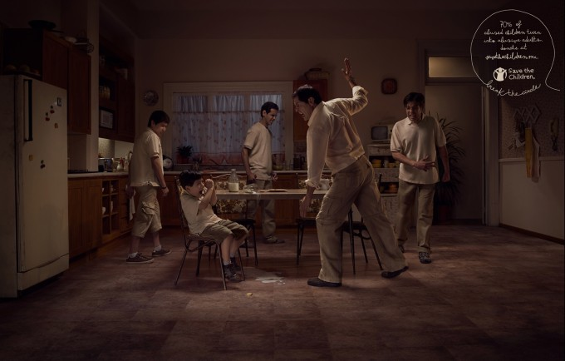
70% of
abused children turn
into abusive adults.
Donate at
savethechildren.mx
break the circle
What is the message of this ad, and how does this image affect the message?
You have 30 seconds to write down your immediate response to the ad that you are about to see.

Slide 9
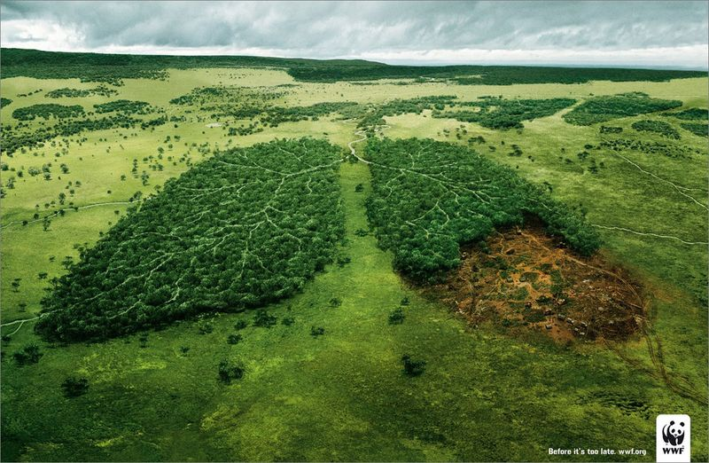
In five words or less, what does this image represent?
What is the ad’s message?
“Before its too late. wwf.org”

Slide 10
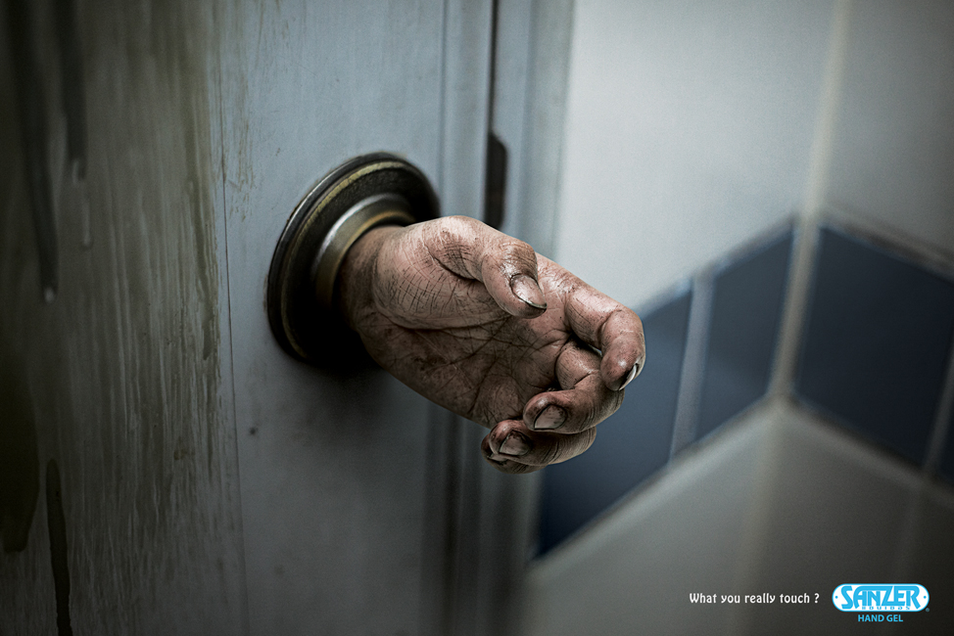
You have 30 seconds to write down your immediate response to the ad that you are about to see.
How is this image effective in delivering the message of this ad? How could this ad have been INeffective?
What do you really touch?
HAND GEL

Slide 11
PUBLIC SERVICE ADS
USING STRONG TEXT

Slide 12
In ONE word, predict what this ad is about.
How is persuasion being used in this ad?
How would you change this ad?

Slide 13
Write down your immediate response to the following ad.
What persuasive techniques are used and for what purpose?
What assumptions are being made with this ad?

Slide 14
a. ethos?
b. pathos?
c. logos?
How is the layout of this ad connected to the persuasive technique(s) being used?

Slide 15
PUBLIC SERVICE ADS
USING STRONG IMAGES AND TEXT

Slide 16
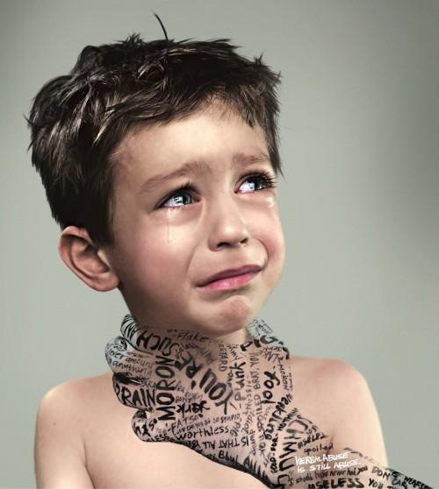
Explain how the image and text impact the ad separately and how they impact the ad together.

Slide 17
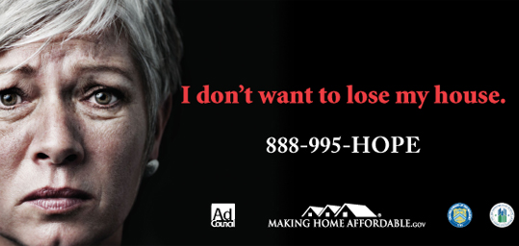
How could you incorporate ethos, pathos, and logos into this ad?
Make 3 observations about this ad.

Slide 18
What is the significance of the setting of this ad?
What does AAUW stand for, and why is the full name of the organization not on the ad?
Make 3 observations about this ad.
Why is this info included in the ad?

